Slide 1
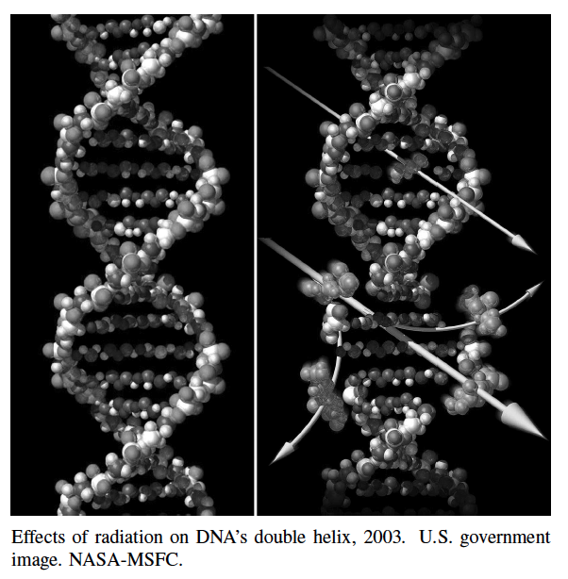
Dynamic Programming
Presentation for use with the textbook, Algorithm Design and Applications, by M. T. Goodrich and R. Tamassia, Wiley, 2015

Slide 2
Application: DNA Sequence Alignment
DNA sequences can be viewed as strings of A, C, G, and T characters, which represent nucleotides.
Finding the similarities between two DNA sequences is an important computation performed in bioinformatics.
For instance, when comparing the DNA of different organisms, such alignments can highlight the locations where those organisms have identical DNA patterns.

Slide 3
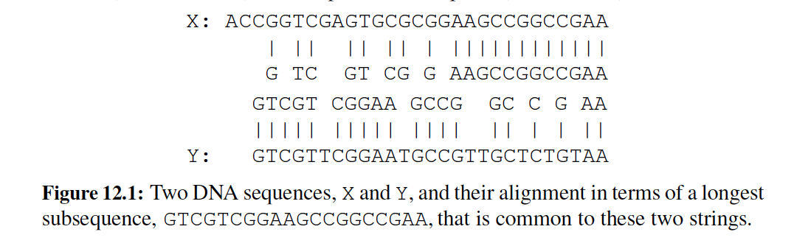
Application: DNA Sequence Alignment
Finding the best alignment between two DNA strings involves minimizing the number of changes to convert one string to the other.
A brute-force search would take exponential time, but we can do much better using dynamic programming.

Slide 4
Warm-up: Matrix Chain-Products
Dynamic Programming is a general algorithm design paradigm.
Rather than give the general structure, let us first give a motivating example:
Matrix Chain-Products
Review: Matrix Multiplication.
C = A*B
A is d × e and B is e × f
O(def ) time
f
B
j
e
e
A
C
d
i
i,j
d
f

Slide 5
Matrix Chain-Products
Matrix Chain-Product:
Compute A=A₀*A₁*…*A_{n-1}
A_{i} is d_{i} × d_{i+1}
Problem: How to parenthesize?
Example
B is 3 × 100
C is 100 × 5
D is 5 × 5
(B*C)*D takes 1500 + 75 = 1575 ops
B*(C*D) takes 1500 + 2500 = 4000 ops

Slide 6
An Enumeration Approach
Matrix Chain-Product Alg.:
Try all possible ways to parenthesize A=A₀*A₁*…*A_{n-1}
Calculate number of ops for each one
Pick the one that is best
Running time:
The number of paranethesizations is equal to the number of binary trees with n nodes
This is exponential!
It is called the Catalan number, and it is almost 4^{n}.
This is a terrible algorithm!

Slide 7
A Greedy Approach
Idea #1: repeatedly select the product that uses (up) the most operations.
Counter-example:
A is 10 × 5
B is 5 × 10
C is 10 × 5
D is 5 × 10
Greedy idea #1 gives (A*B)*(C*D), which takes 500+1000+500 = 2000 ops
A*((B*C)*D) takes 500+250+250 = 1000 ops

Slide 8
Another Greedy Approach
Idea #2: repeatedly select the product that uses the fewest operations.
Counter-example:
A is 101 × 11
B is 11 × 9
C is 9 × 100
D is 100 × 99
Greedy idea #2 gives A*((B*C)*D)), which takes 109989+9900+108900=228789 ops
(A*B)*(C*D) takes 9999+89991+89100=189090 ops
The greedy approach is not giving us the optimal value.

Slide 9
A “Recursive” Approach
Define subproblems:
Find the best parenthesization of A_{i}*A_{i+1}*…*A_{j}.
Let N_{i,j} denote the number of operations done by this subproblem.
The optimal solution for the whole problem is N_{0,n-1}.
Subproblem optimality: The optimal solution can be defined in terms of optimal subproblems
There has to be a final multiplication (root of the expression tree) for the optimal solution.
Say, the final multiply is at index i: (A₀*…*A_{i})*(A_{i+1}*…*A_{n-1}).
Then the optimal solution N_{0,n-1} is the sum of two optimal subproblems, N_{0,i} and N_{i+1,n-1} plus the time for the last multiply.
If the global optimum did not have these optimal subproblems, we could define an even better “optimal” solution.

Slide 10
A Characterizing Equation
The global optimal has to be defined in terms of optimal subproblems, depending on where the final multiply is at.
Let us consider all possible places for that final multiply:
Recall that A_{i} is a d_{i} × d_{i+1} dimensional matrix.
So, a characterizing equation for N_{i,j} is the following:
Note that subproblems are not independent--the subproblems overlap.

Slide 11
A Dynamic Programming Algorithm
Since subproblems overlap, we don’t use recursion.
Instead, we construct optimal subproblems “bottom-up.”
N_{i,i}’s are easy, so start with them
Then do length 2,3,… subproblems, and so on.
The running time is O(n³)
Algorithm matrixChain(S):
Input: sequence S of n matrices to be multiplied
Output: number of operations in an optimal paranethization of S
for i ← 1 to n-1 do
N_{i,i} ← 0
for b ← 1 to n-1 do
for i ← 0 to n-b-1 do
j ← i+b
N_{i,j} ← +infinity
for k ← i to j-1 do
N_{i,j} ← min{N_{i,j} , N_{i,k} +N_{k+1,j} +d_{i} d_{k+1} d_{j+1}}

Slide 12
A Dynamic Programming Algorithm Visualization
The bottom-up construction fills in the N array by diagonals
N_{i,j} gets values from pervious entries in i-th row and j-th column
Filling in each entry in the N table takes O(n) time.
Total run time: O(n³)
Getting actual parenthesization can be done by remembering “k” for each N entry
answer
N
0
1
2
j
…
n-1
0
1
…
i
n-1

Slide 13
The General Dynamic Programming Technique
Applies to a problem that at first seems to require a lot of time (possibly exponential), provided we have:
Simple subproblems: the subproblems can be defined in terms of a few variables, such as j, k, l, m, and so on.
Subproblem optimality: the global optimum value can be defined in terms of optimal subproblems
Subproblem overlap: the subproblems are not independent, but instead they overlap (hence, should be constructed bottom-up).

Slide 14
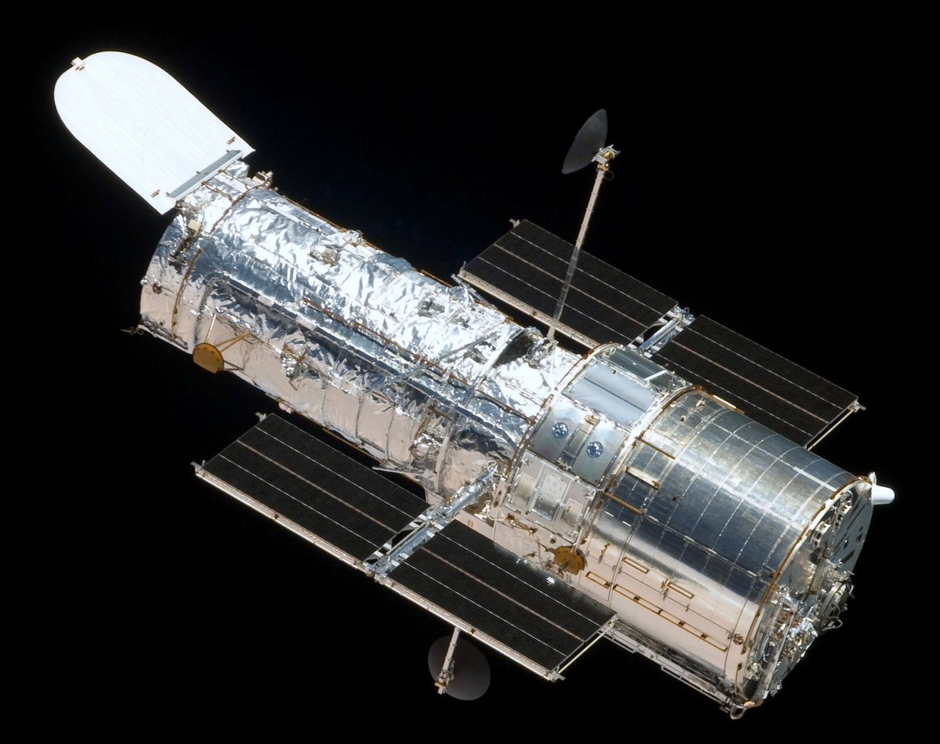
Dynamic Programming: Telescope Scheduling
Presentation for use with the textbook, Algorithm Design and Applications, by M. T. Goodrich and R. Tamassia, Wiley, 2015
Hubble Space Telescope. Public domain image, NASA, 2009.

Slide 15
Motivation
Large, powerful telescopes are precious resources that are typically oversubscribed by the astronomers who request times to use them.
This high demand for observation times is especially true, for instance, for a space telescope, which could receive thousands of observation requests per month.

Slide 16
Telescope Scheduling Problem
The input to the telescope scheduling problem is a list, L, of observation requests, where each request, i, consists of the following elements:
a requested start time, s_{i}, which is the moment when a requested observation should begin
a finish time, f_{i}, which is the moment when the observation should finish (assuming it begins at its start time)
a positive numerical benefit, b_{i}, which is an indicator of the scientific gain to be had by performing this observation.
The start and finish times for an observation request are specified by the astronomer requesting the observation; the benefit of a request is determined by an administrator or a review committee.

Slide 17
Telescope Scheduling Problem
To get the benefit, b_{i}, for an observation request, i, that observation must be performed by the telescope for the entire time period from the start time, s_{i}, to the finish time, f_{i}.
Thus, two requests, i and j, conflict if the time interval [s_{i}, f_{i}], intersects the time interval, [s_{j}, f_{j}].
Given the list, L, of observation requests, the optimization problem is to schedule observation requests in a nonconflicting way so as to maximize the total benefit of the observations that are included in the schedule.

Slide 18
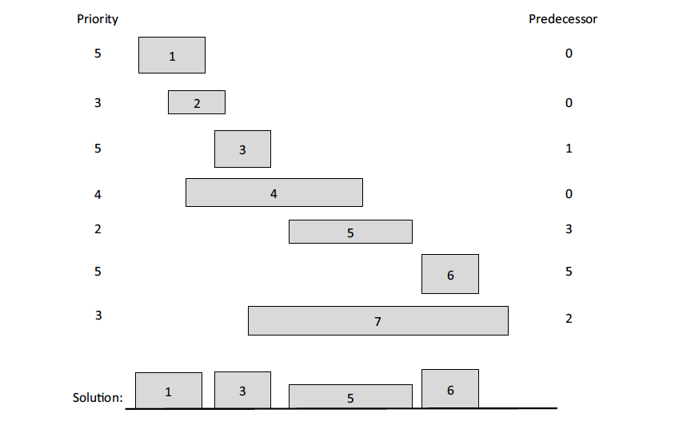
Example
The left and right boundary of each rectangle represent the start and finish times for an observation request. The height of each rectangle represents its benefit. We list each request’s benefit (Priority) on the left. The optimal solution has total benefit 17=5+5+2+5.

Slide 19
False Start 1: Brute Force
There is an obvious exponential-time algorithm for solving this problem, of course, which is to consider all possible subsets of L and choose the one that has the highest total benefit without causing any scheduling conflicts.
Implementing this brute-force algorithm would take O(n2^{n}) time, where n is the number of observation requests.
We can do much better than this, however, by using the dynamic programming technique.

Slide 20
False Start 2: Greedy Method
A natural greedy strategy would be to consider the observation requests ordered by nonincreasing benefits, and include each request that doesn’t conflict with any chosen before it.
This strategy doesn’t lead to an optimal solution, however.
For instance, suppose we had a list containing just 3 requests—one with benefit 100 that conflicts with two nonconflicting requests with benefit 75 each.
The greedy method would choose the observation with benefit 100, whereas we can achieve a total benefit of 150 by taking the two requests with benefit 75 each.
So a greedy strategy based on repeatedly choosing a nonconflicting request with maximum benefit won’t work.

Slide 21
The General Dynamic Programming Technique
Applies to a problem that at first seems to require a lot of time (possibly exponential), provided we have:
Simple subproblems: the subproblems can be defined in terms of a few variables, such as j, k, l, m, and so on.
Subproblem optimality: the global optimum value can be defined in terms of optimal subproblems
Subproblem overlap: the subproblems are not independent, but instead they overlap (hence, should be constructed bottom-up).

Slide 22
Defining Simple Subproblems
A natural way to define subproblems is to consider the observation requests according to some ordering, such as ordered by start times, finish times, or benefits.
We already saw that ordering by benefits is a false start.
Start times and finish times are essentially symmetric, so let us order observations by finish times.

Slide 23
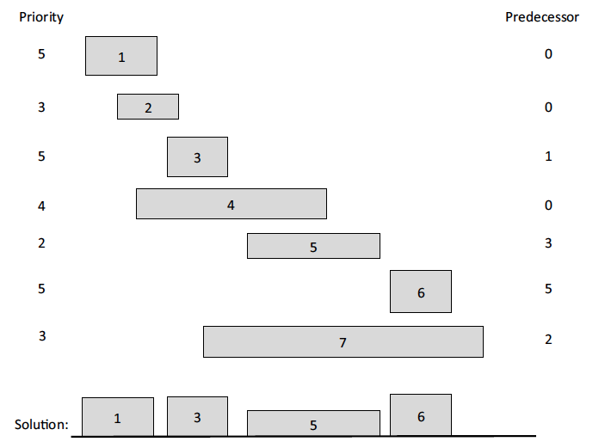
Predecessors
For any request i, the set of other requests that conflict with i form a contiguous interval of requests in L.
Define the predecessor, pred(i), for each request, i, then, to be the largest index, j < i, such that requests i and j don’t conflict. If there is no such index, then define the predecessor of i to be 0.

Slide 24
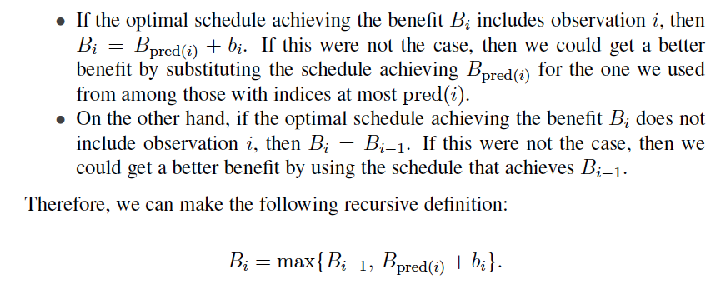
Subproblem Optimality
A schedule that achieves the optimal value, B_{i}, either includes observation i or not.

Slide 25
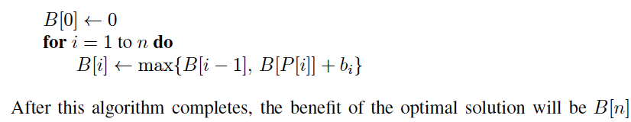
Subproblem Overlap
The above definition has subproblem overlap.
Thus, it is most efficient for us to use memoization when computing B_{i} values, by storing them in an array, B, which is indexed from 0 to n.
Given the ordering of requests by finish times and an array, P, so that P[i] = pred(i), then we can fill in the array, B, using the following simple algorithm:

Slide 26
Analysis of the Algorithm
It is easy to see that the running time of this algorithm is O(n), assuming the list L is ordered by finish times and we are given the predecessor for each request i.
Of course, we can easily sort L by finish times if it is not given to us already sorted according to this ordering.
To compute the predecessor of each request, note that it is sufficient that we also have the requests in L sorted by start times.
In particular, given a listing of L ordered by finish times and another listing, L′, ordered by start times, then a merging of these two lists, as in the merge-sort algorithm (Section 8.1), gives us what we want.
The predecessor of request i is literally the index of the predecessor in L of the value, s_{i}, in L′.

Slide 27
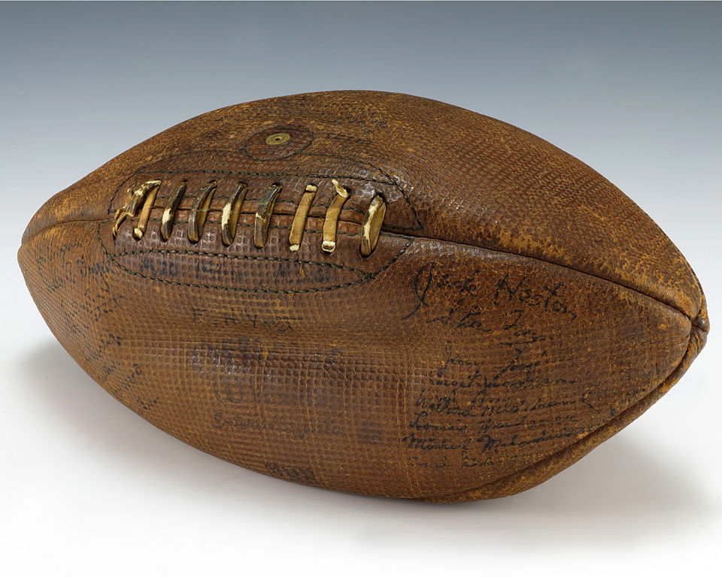
Dynamic Programming: Game Strategies
Presentation for use with the textbook, Algorithm Design and Applications, by M. T. Goodrich and R. Tamassia, Wiley, 2015
Football signed by President Gerald Ford when playing for University of Michigan. Public domain image.

Slide 28
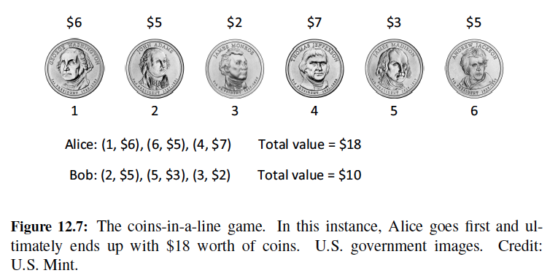
Coins in a Line
“Coins in a Line” is a game whose strategy is sometimes asked about during job interviews.
In this game, an even number, n, of coins, of various denominations, are placed in a line.
Two players, who we will call Alice and Bob, take turns removing one of the coins from either end of the remaining line of coins.
The player who removes a set of coins with larger total value than the other player wins and gets to keep the money. The loser gets nothing.
Alice’s goal: get the most.

Slide 29
False Start 1: Greedy Method
A natural greedy strategy is “always choose the largest-valued available coin.”
But this doesn’t always work:
[5, 10, 25, 10]: Alice chooses 10
[5, 10, 25]: Bob chooses 25
[5, 10]: Alice chooses 10
[5]: Bob chooses 5
Alice’s total value: 20, Bob’s total value: 30. (Bob wins, Alice loses)

Slide 30
False Start 2: Greedy Method
Another greedy strategy is “choose odds or evens, whichever is better.”
Alice can win with this strategy, but won’t necessarily get the most money.
Example: [1, 3, 6, 3, 1, 3]
Alice’s total value: $9, Bob’s total value: $8.
Alice wins $9, but could have won $10.
How?

Slide 31
The General Dynamic Programming Technique
Applies to a problem that at first seems to require a lot of time (possibly exponential), provided we have:
Simple subproblems: the subproblems can be defined in terms of a few variables, such as j, k, l, m, and so on.
Subproblem optimality: the global optimum value can be defined in terms of optimal subproblems
Subproblem overlap: the subproblems are not independent, but instead they overlap (hence, should be constructed bottom-up).

Slide 32
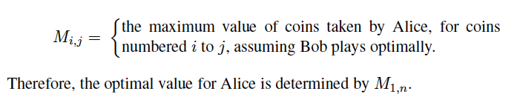
Defining Simple Subproblems
Since Alice and Bob can remove coins from either end of the line, an appropriate way to define subproblems is in terms of a range of indices for the coins, assuming they are initially numbered from 1 to n.
Thus, let us define the following indexed parameter:

Slide 33
Subproblem Optimality
Let us assume that the values of the coins are stored in an array, V, so that coin 1 is of Value V[1], coin 2 is of Value V[2], and so on.
Note that, given the line of coins from coin i to coin j, the choice for Alice at this point is either to take coin i or coin j and thereby gain a coin of value V[i] or V[j].
Once that choice is made, play turns to Bob, who we are assuming is playing optimally.
We should assume that Bob will make the choice among his possibilities that minimizes the total amount that Alice can get from the coins that remain.

Slide 34
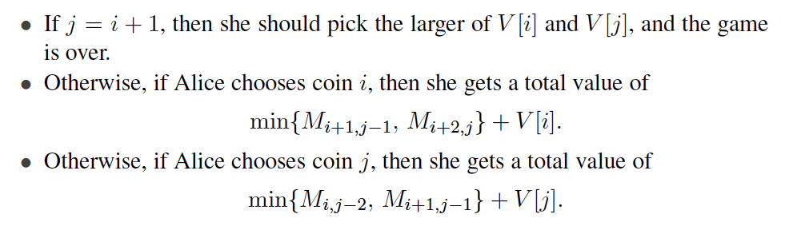
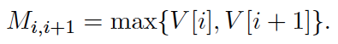
Subproblem Overlap
Alice should choose based on the following:
That is, we have initial conditions, for i=1,2,…,n-1:
And general equation:

Slide 35
Analysis of the Algorithm
We can compute the M_{i,j} values, then, using memoization, by starting with the definitions for the above initial conditions and then computing all the M_{i,j}’s where j − i + 1 is 4, then for all such values where j − i + 1 is 6, and so on.
Since there are O(n) iterations in this algorithm and each iteration runs in O(n) time, the total time for this algorithm is O(n²).
To recover the actual game strategy for Alice (and Bob), we simply need to note for each M_{i,j} whether Alice should choose coin i or coin j.

Slide 36
Dynamic Programming: Longest Common Subsequences
Presentation for use with the textbook, Algorithm Design and Applications, by M. T. Goodrich and R. Tamassia, Wiley, 2015

Slide 37
Application: DNA Sequence Alignment
DNA sequences can be viewed as strings of A, C, G, and T characters, which represent nucleotides.
Finding the similarities between two DNA sequences is an important computation performed in bioinformatics.
For instance, when comparing the DNA of different organisms, such alignments can highlight the locations where those organisms have identical DNA patterns.

Slide 38
Application: DNA Sequence Alignment
Finding the best alignment between two DNA strings involves minimizing the number of changes to convert one string to the other.
A brute-force search would take exponential time, but we can do much better using dynamic programming.

Slide 39
The General Dynamic Programming Technique
Applies to a problem that at first seems to require a lot of time (possibly exponential), provided we have:
Simple subproblems: the subproblems can be defined in terms of a few variables, such as j, k, l, m, and so on.
Subproblem optimality: the global optimum value can be defined in terms of optimal subproblems
Subproblem overlap: the subproblems are not independent, but instead they overlap (hence, should be constructed bottom-up).

Slide 40
Subsequences
A subsequence of a character string x₀x₁x₂…x_{n-1} is a string of the form x_{i1}x_{i2}…x_{ik}, where ij < ij+1.
Not the same as substring!
Example String: ABCDEFGHIJK
Subsequence: ACEGJIK
Subsequence: DFGHK
Not subsequence: DAGH

Slide 41
The Longest Common Subsequence (LCS) Problem
Given two strings X and Y, the longest common subsequence (LCS) problem is to find a longest subsequence common to both X and Y
Has applications to DNA similarity testing (alphabet is {A,C,G,T})
Example: ABCDEFG and XZACKDFWGH have ACDFG as a longest common subsequence

Slide 42
A Poor Approach to the LCS Problem
A Brute-force solution:
Enumerate all subsequences of X
Test which ones are also subsequences of Y
Pick the longest one.
Analysis:
If X is of length n, then it has 2^{n} subsequences
This is an exponential-time algorithm!

Slide 43
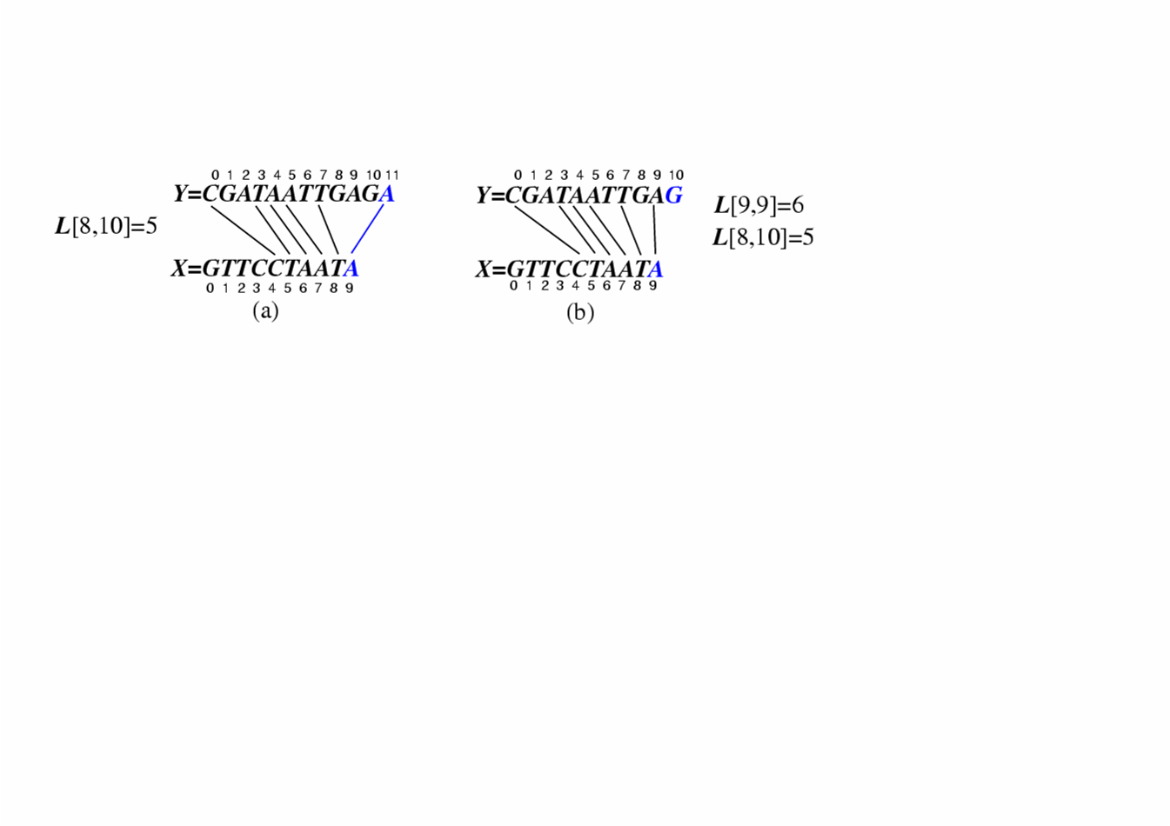
A Dynamic-Programming Approach to the LCS Problem
Define L[i,j] to be the length of the longest common subsequence of X[0..i] and Y[0..j].
Allow for -1 as an index, so L[-1,k] = 0 and L[k,-1]=0, to indicate that the null part of X or Y has no match with the other.
Then we can define L[i,j] in the general case as follows:
If xi=yj, then L[i,j] = L[i-1,j-1] + 1 (we can add this match)
If xi≠yj, then L[i,j] = max{L[i-1,j], L[i,j-1]} (we have no match here)
Case 1:
Case 2:

Slide 44
An LCS Algorithm
Algorithm LCS(X,Y ):
Input: Strings X and Y with n and m elements, respectively
Output: For i = 0,…,n-1, j = 0,...,m-1, the length L[i, j] of a longest string that is a subsequence of both the string X[0..i] = x₀x₁x₂…x_{i} and the string Y [0.. j] = y₀y₁y₂…y_{j}
for i =1 to n-1 do
L[i,-1] = 0
for j =0 to m-1 do
L[-1,j] = 0
for i =0 to n-1 do
for j =0 to m-1 do
if x_{i} = y_{j} then
L[i, j] = L[i-1, j-1] + 1
else
L[i, j] = max{L[i-1, j] , L[i, j-1]}
return array L

Slide 45
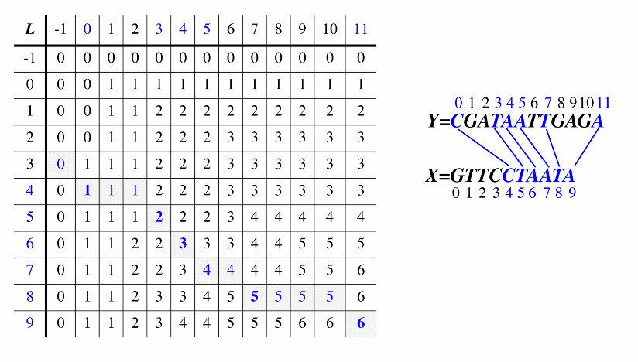
Visualizing the LCS Algorithm

Slide 46
Analysis of LCS Algorithm
We have two nested loops
The outer one iterates n times
The inner one iterates m times
A constant amount of work is done inside each iteration of the inner loop
Thus, the total running time is O(nm)
Answer is contained in L[n,m] (and the subsequence can be recovered from the L table).

Slide 47
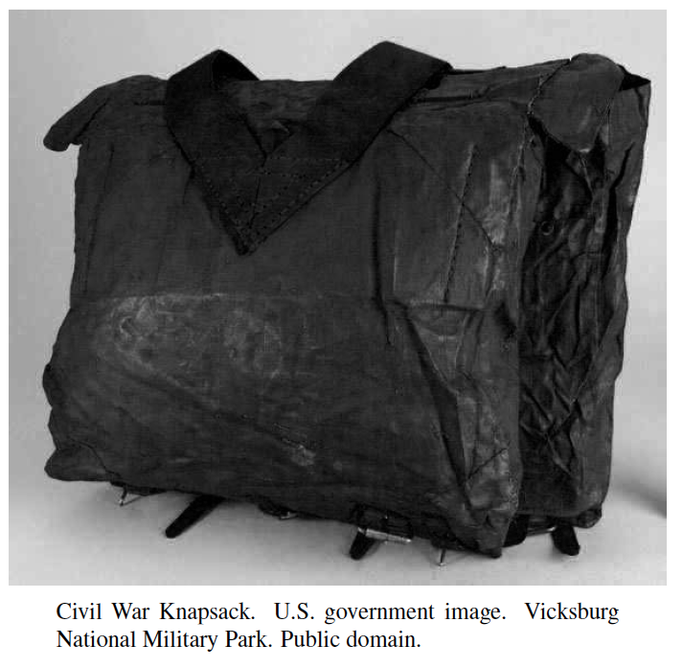
Dynamic Programming: 0/1 Knapsack
Presentation for use with the textbook, Algorithm Design and Applications, by M. T. Goodrich and R. Tamassia, Wiley, 2015

Slide 48
The 0/1 Knapsack Problem
Given: A set S of n items, with each item i having
w_{i} - a positive weight
b_{i} - a positive benefit
Goal: Choose items with maximum total benefit but with weight at most W.
If we are not allowed to take fractional amounts, then this is the 0/1 knapsack problem.
In this case, we let T denote the set of items we take
Objective: maximize
Constraint:

Slide 49

Example
Given: A set S of n items, with each item i having
b_{i} - a positive “benefit”
w_{i} - a positive “weight”
Goal: Choose items with maximum total benefit but with weight at most W.
“knapsack”
Items:
1
2
3
4
5
box of width 9 in
Weight:
Solution:
item 5 ($80, 2 in)
item 3 ($6, 2in)
item 1 ($20, 4in)
4 in
2 in
2 in
6 in
2 in
Benefit:
$20
$3
$6
$25
$80

Slide 50
The General Dynamic Programming Technique
Applies to a problem that at first seems to require a lot of time (possibly exponential), provided we have:
Simple subproblems: the subproblems can be defined in terms of a few variables, such as j, k, l, m, and so on.
Subproblem optimality: the global optimum value can be defined in terms of optimal subproblems
Subproblem overlap: the subproblems are not independent, but instead they overlap (hence, should be constructed bottom-up).

Slide 51
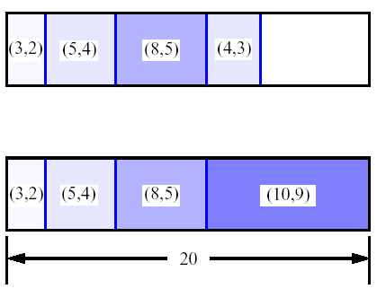
A 0/1 Knapsack Algorithm, First Attempt
S_{k}: Set of items numbered 1 to k.
Define B[k] = best selection from S_{k}.
Problem: does not have subproblem optimality:
Consider set S={(3,2),(5,4),(8,5),(4,3),(10,9)} of (benefit, weight) pairs and total weight W = 20
Best for S₄:
Best for S₅:

Slide 52
A 0/1 Knapsack Algorithm, Second (Better) Attempt
S_{k}: Set of items numbered 1 to k.
Define B[k,w] to be the best selection from S_{k} with weight at most w
Good news: this does have subproblem optimality.
I.e., the best subset of S_{k} with weight at most w is either
the best subset of S_{k-1} with weight at most w or
the best subset of S_{k-1} with weight at most w−w_{k} plus item k

Slide 53
0/1 Knapsack Algorithm
Algorithm 01Knapsack(S, W):
Input: set S of n items with benefit b_{i} and weight w_{i}; maximum weight W
Output: benefit of best subset of S with weight at most W
let A and B be arrays of length W + 1
for w ← 0 to W do
B[w] ← 0
for k ← 1 to n do
copy array B into array A
for w ← w_{k} to W do
if A[w−w_{k}] + b_{k} > A[w] then
B[w] ← A[w−w_{k}] + b_{k}
return B[W]
Recall the definition of B[k,w]
Since B[k,w] is defined in terms of B[k−1,*], we can use two arrays of instead of a matrix
Running time: O(nW).
Not a polynomial-time algorithm since W may be large
This is a pseudo-polynomial time algorithm

